Slide 1
SC2001 / PROJECT 1 / 0:00–0:30
Can a small-array switch make merge sort faster?
Hybrid merge sort
+ insertion sort
1.147×
measured speedup
on fresh 10m-element arrays
Choose a threshold S. Measure both CPU time and key comparisons.
n = input length S = insertion-sort threshold
Research question: does the fastest S also minimize comparisons?
MERGE SORT + INSERTION SORT
01
Notes:
30 seconds. Explain the research question. The headline is a measured result on this implementation, not a universal claim. Add team names and lab group if desired before presenting.
## Slide 1 — Can a small-array switch make merge sort faster? (0:00–0:30)
**On slide**
- Hybrid merge sort + insertion sort.
- n = input length; S = insertion-sort threshold.
- Question: which S minimizes CPU time, and does it also minimize comparisons?
- Team member names and lab group.
**Visual:** one simple pipeline: split → insertion-sort small leaves → merge.
**Say:** “Merge sort scales well, but recursive splitting and merging add overhead on small subarrays. We keep its structure and replace only the small-leaf work. We measure both key comparisons and CPU time because they need not favor the same threshold.”
**Transition:** “Here is the exact switch we implemented.”

Slide 2
ALGORITHM & CORRECTNESS / (a) / 0:30–1:40
Sort small leaves; merge the sorted halves
n=16, S=4
hybrid(A, left, right, S):
if right-left <= 1: return
if right-left <= S:
insertionSort(A, left, right)
return
mid = left + (right-left)/2
hybrid(A, left, mid, S)
hybrid(A, mid, right, S)
merge(A, left, mid, right)
16
8
8
4
4
4
4
Insertion sort at the four leaves
Sorted leaves → sorted halves → sorted whole
Stable ties • one reusable buffer
MERGE SORT + INSERTION SORT
02
Notes:
70 seconds. Tree nodes show subarray lengths. Correctness follows from insertion-sort invariant and induction through stable merge. Half-open intervals exclude the right endpoint.
## Slide 2 — Sort small leaves, then merge sorted halves (0:30–1:40)
**On slide:** the following pseudocode, with a recursion tree beside it.
```text
hybrid(A, left, right, S):
if right-left <= 1: return
if right-left <= S:
insertionSort(A, left, right)
return
mid = left + (right-left)/2
hybrid(A, left, mid, S)
hybrid(A, mid, right, S)
merge(A, left, mid, right)
```
**Tree:** n=16, S=4: one 16 node → two 8 nodes → four highlighted 4-element leaves. Label leaves “insertion sort,” upper levels “merge.”
**Footer:** stable; one reusable auxiliary array; tests against `std::sort`.
**Say:** “Intervals exclude the right endpoint. Insertion sort maintains a sorted prefix, so every leaf is sorted. By induction, recursive calls return sorted halves. Merge repeatedly selects the smaller front element, so the combined interval is sorted and preserves all elements. Insertion shifts only strictly larger values, and merge takes the left value on ties, preserving stability.”
**Code reference:** `src/sorting.hpp`. Show pseudocode rather than a screenshot of the whole source file.

Slide 3
THEORETICAL ANALYSIS / (c) / 1:40–2:40
The threshold trades leaf work for merge levels
Insertion-sort leaves
Merge levels
About n/S leaves × O(S²) work per leaf
About log₂(n/S) levels × O(n) work per level
T(n,S) = O(nS + n log₂(n/S))
Worst-case bound for 1 ≤ S ≤ n; not an exact random-input count.
Fixed S
S = 1
S ≥ n
Θ(n log n) worst case
Ordinary merge sort
Insertion sort: O(n²) worst case
MERGE SORT + INSERTION SORT
03
Notes:
60 seconds. Auxiliary storage O(n), plus O(log(n/S)+1) recursive stack depth for 1≤S≤n. Do not claim differentiation of the bound identifies a universal threshold.
## Slide 3 — Threshold trades insertion work for merge levels (1:40–2:40)
**On slide**
\[
\underbrace{O((n/S)S^2)}_{\text{small-leaf sorting}}+
\underbrace{O(n\log_2(n/S))}_{\text{merge levels}}
=O(nS+n\log_2(n/S)).
\]
- Fixed S: Θ(n log n) worst case.
- S=1: ordinary merge sort. S≥n: insertion sort.
- Auxiliary space: O(n), plus recursion stack.
**Say:** “Roughly n/S leaves each require at most quadratic insertion work in S. Each merge level processes at most n elements, and there are roughly log₂(n/S) levels. Increasing S reduces merge levels but increases insertion work. This is a worst-case growth bound, not an exact curve for random data and not a formula that directly tells us the fastest threshold.”
**Precision for questions:** for non-power-of-two sizes, leaves differ by at most one within a depth and can occur at adjacent depths; the asymptotic bound survives rounding. For n≥2 and 1≤S≤n, insertion leaf lengths are O(S). Fixed S gives the usual worst-case lower and upper order. For S≥n, cap the leaf size at n.

Slide 4
EXPERIMENTAL METHOD / (b)–(d) / 2:40–3:30
Choose S on tuning data; validate on fresh data
01 Generate
02 Tune
03 Validate
Uniform integers in [1, 10⁷]
Nine sizes: 10³ to 10⁷
Five seeds × three repetitions
Coarse sweep, then integer refinement
Lock S before testing
Five fresh 10m-element datasets
Fair timing
Trustworthy evidence
Same arrays across candidates
Warm-up + shuffled run order
Time sorting only; compile counters out
Every output checked against std::sort
Median within seed, then across seeds
Error bands = IQR, not confidence intervals
Apple M5 • C++17 / Apple clang 21 / -O3 • separate key-comparison passes
MERGE SORT + INSERTION SORT
04
Notes:
50 seconds. CPU means process CPU via std::clock, not elapsed wall time. Generation, copying, allocations, checks and CSV output are outside timing. See appendix for exact seeds and counting definitions.
## Slide 4 — Fair inputs, isolated timing, fresh validation (2:40–3:30)
**On slide**
- Uniform integers in [1, 10⁷]; n from 10³ to 10⁷.
- Five tuning seeds; three timed repetitions per seed.
- Same inputs across candidates; shuffled configuration order and warm-up.
- Timers cover sorting only; counters compiled out of timed runs.
- Choose S first; compare on five fresh seeds.
- Machine/build: insert verified metadata from the measured content file.
**Say:** “A key comparison is a comparison of two data values, including a false comparison that terminates insertion. Index checks are excluded. We count in a separate pass. We summarize repetitions within each seed, then summarize across seeds. Bands are interquartile ranges, not confidence intervals. Every sort is checked against a reference outside the timer.”

Slide 5
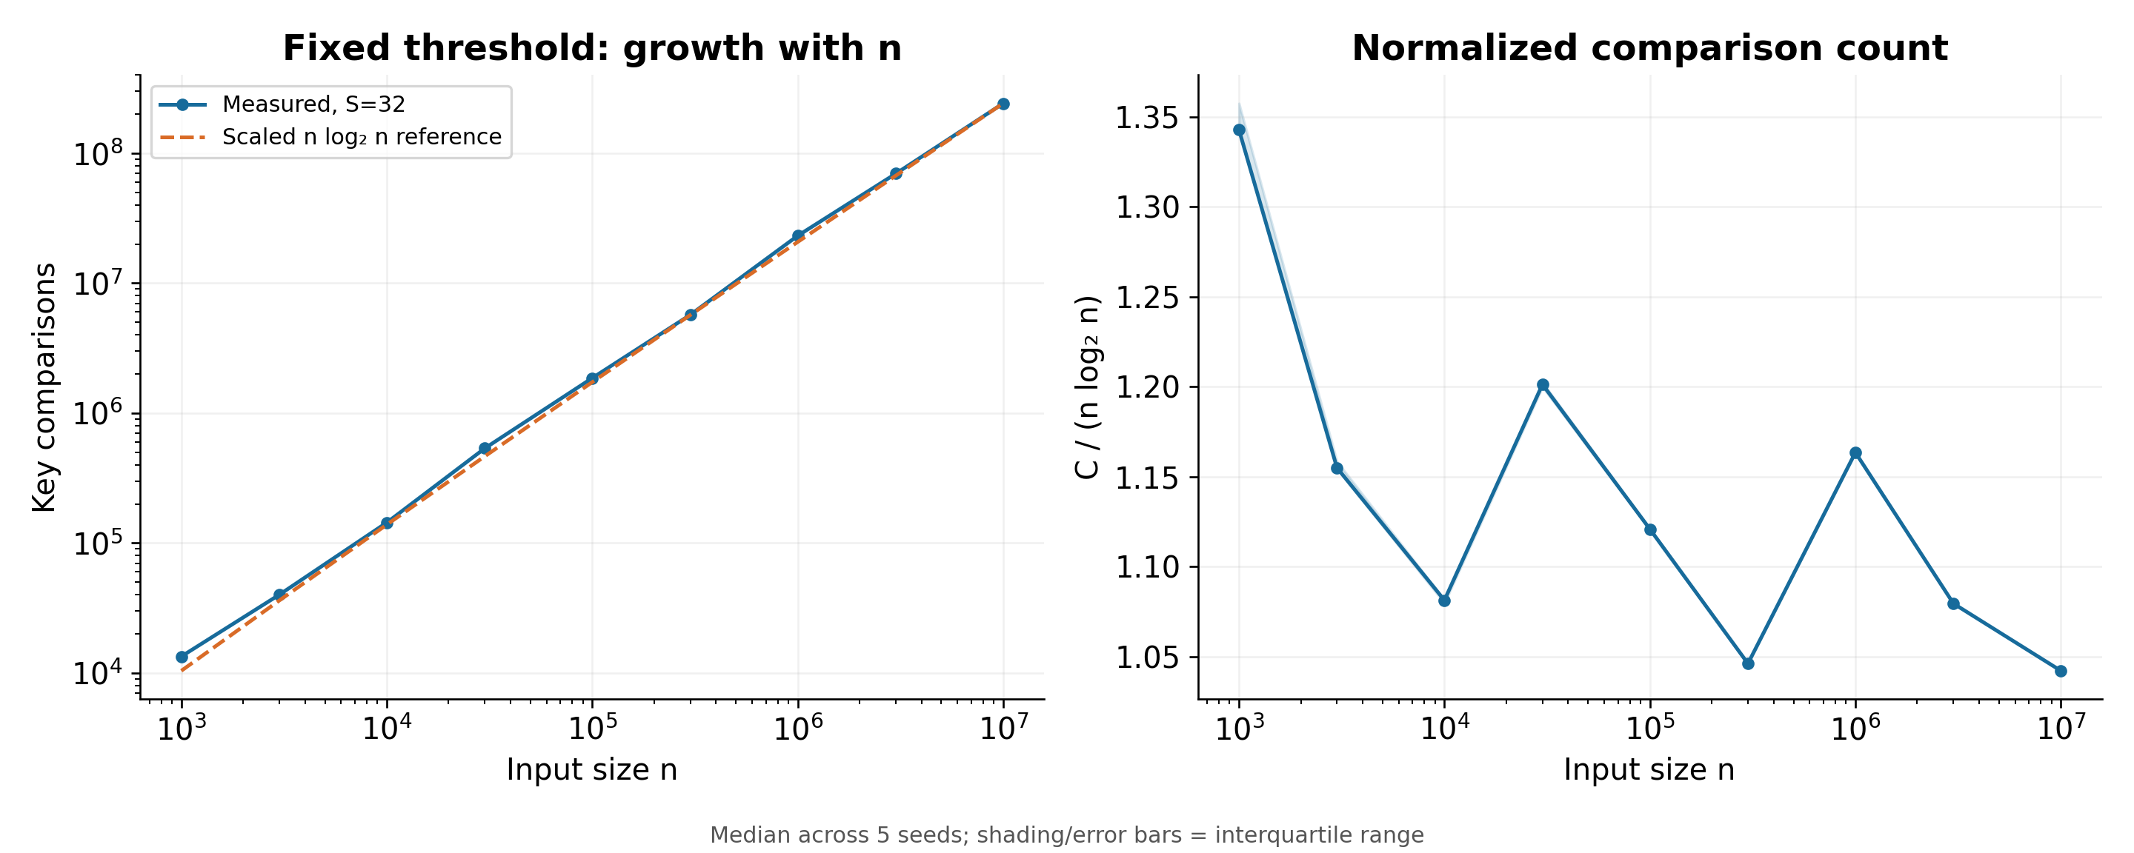
EMPIRICAL ANALYSIS / (c)(i) / 3:30–4:25
Fixed S: comparison growth agrees with n log n
S=32 • normalized ratio 1.042–1.343 • finite-size leaf effects explain the variation
MERGE SORT + INSERTION SORT
05
Notes:
55 seconds. The right panel is not perfectly flat: actual leaf sizes vary as n changes, changing insertion work per element. The dashed reference is scaled to the largest point and is not an independently predicted count. Data is consistent with the bound; the derivation establishes it.
## Slide 5 — Does comparison growth agree with theory? (3:30–4:25)
**Visual:** `figures/01_fixed_s.png` occupying most of the slide. Retain both panels.
**On slide:** “S=32, nine input sizes.” Add one measured sentence from `slides/measured_content.md` about the normalized range.
**Say:** “The left panel shows the growth of key comparisons on logarithmic axes. The dashed curve is n log₂n scaled to the largest data point, so it is a reference, not a theoretical prediction of the exact count. The right panel divides by n log₂n. A broadly stable ratio supports the fixed-threshold growth prediction. Finite-size changes and leaf work explain why the ratio need not be perfectly constant.”
**Avoid:** claiming that any straight log-log plot proves n log n, or asserting the fitted reference validates an exact formula.

Slide 6
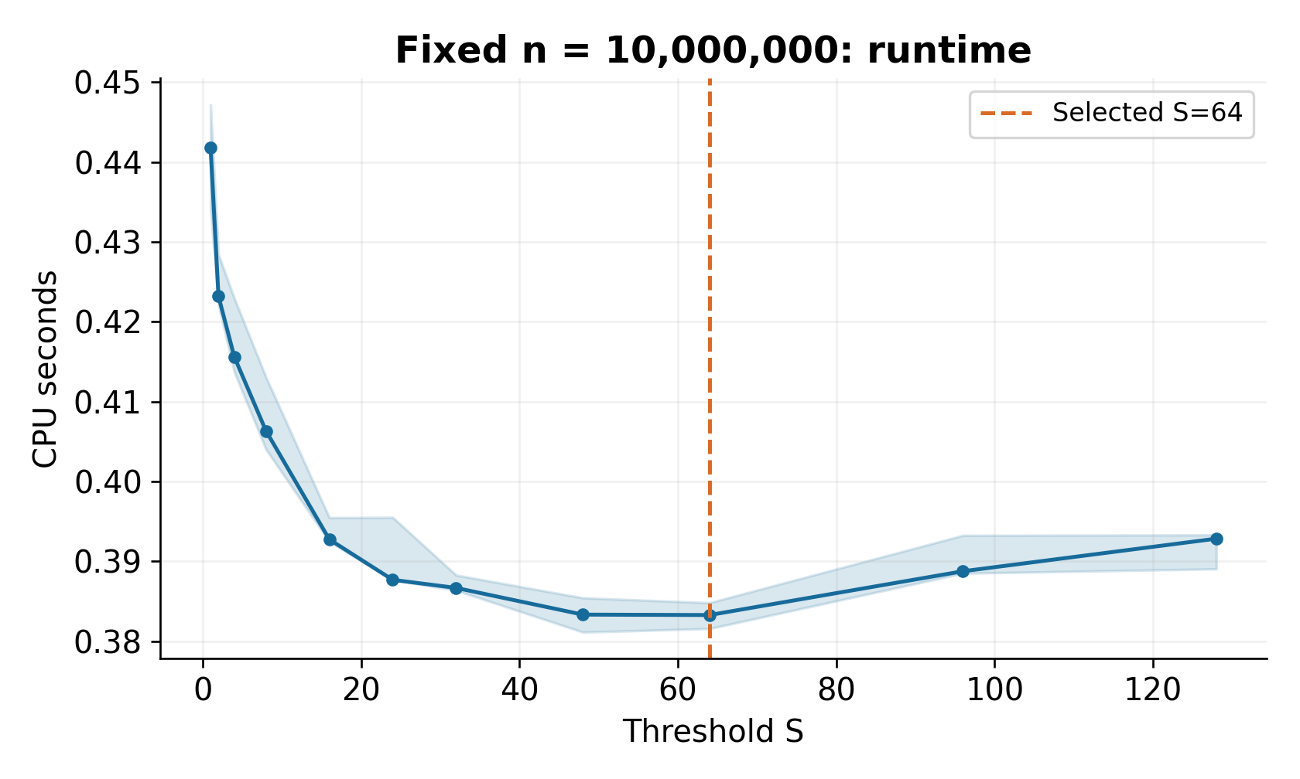
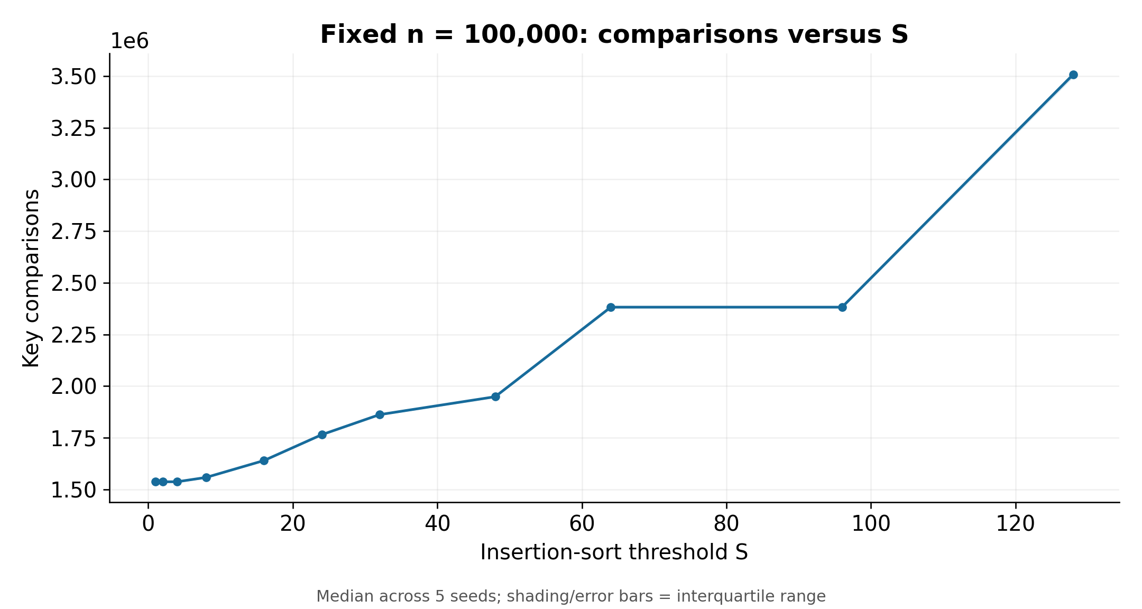
THRESHOLD SELECTION / (c)(ii)–(iii) / 4:25–5:45
Fastest runtime does not mean fewest comparisons
Selected S=64
Coarse winners by n
Minimum comparisons at 10m: S=1
10k: 48 · 100k: 96 · 1m: 32 · 10m: 64
MERGE SORT + INSERTION SORT
06
Notes:
80 seconds. Left: fixed n=100k key comparisons. Right: coarse CPU timings at 10m. All four CPU curves and the refinement graph are in backup slides. The selected S=64 remains the best measured candidate after refining 48–96. S=39–75 generates the same leaves at 10m, so exact ranking within that plateau is not algorithmically meaningful. Later refinement timings differ from reused coarse timings; do not hide this phase limitation.
## Slide 6 — Runtime and comparisons favor different tradeoffs (4:25–5:45)
**Visual layout:** left 40%: `02_fixed_n.png`; right 60%: `03_threshold_cpu.png`. Use a build/animation or two sequential reveals on the same slide if labels are too small. Put the detailed refinement graph in the appendix.
**On slide**
- Comparison sweep at n=100,000.
- CPU sweeps at four sizes; orange points mark coarse winners.
- Fine search at 10m → selected S from actual results.
- Several S values can create identical recursion leaves.
**Say:** “Fewer key comparisons do not necessarily mean less CPU time. Small insertion-sort leaves can avoid recursive calls and buffer copying even when they make more comparisons. The curves are stepped because the switch depends on actual recursive subarray sizes. We refine around the coarse winner at 10 million and freeze the measured winner before testing fresh seeds. Nearby thresholds with similar times should be described as a fast region rather than a sharply established universal optimum.”
Use a result-dependent headline after checking the actual curves; if the claimed tradeoff does not appear, replace the headline with “Measured effect of the threshold.”

Slide 7
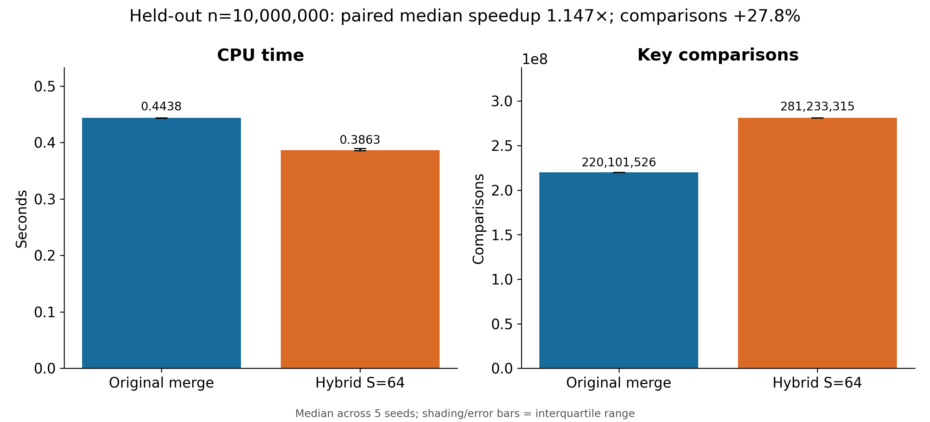
HELD-OUT COMPARISON / (d) / 5:45–6:45
Hybrid S=64: 1.147× speedup with 27.8% more comparisons
Speedup = median of per-seed time ratios • IQR: 1.138–1.152× • 5 fresh datasets
MERGE SORT + INSERTION SORT
07
Notes:
60 seconds. Median CPU: original 0.443770s; hybrid 0.386277s. Median comparisons: 220,101,526 vs 281,233,315. Speedup uses paired seed ratios, not the ratio of overall medians. The result supports a runtime benefit here despite greater comparison work; no universal claim.
## Slide 7 — Held-out comparison at ten million integers (5:45–6:45)
**Visual:** `figures/06_validation.png` full width.
**On slide:** exact selected S, original/hybrid CPU medians, paired speedup and comparison percentage change. Copy from `slides/measured_content.md`.
**Say:** “These seeds were not used to choose S. Both algorithms sort identical arrays. The speedup is original CPU time divided by hybrid CPU time, computed within each seed and then summarized. The error bars show the variation across seeds. Our conclusion is limited to this implementation, machine, and input distribution.”
If hybrid is slower, say so directly. Do not change S after seeing validation.

Slide 8
DEMONSTRATION & CONCLUSION / 6:45–8:00
Correctness, scaling, and a measured runtime benefit
LIVE DEMO
01 Correctness checks passed
02 Fixed-S growth fits the analysis
03 Faster runtime, more comparisons
./build/demo
Input: 7 2 5 1 6 3 4 2
Output: 1 2 2 3 4 5 6 7
Merge / S=1: 17 comparisons
S=4: 19 • S=8: 22
Limit: one implementation and machine;
the exact best S is sensitive to timing variation.
Questions / 2 minutes
MERGE SORT + INSERTION SORT
08
Notes:
75 seconds: about 35s for demo and 40s for conclusions. Do not run the full benchmark live. Saved fallback: slides/demo-output.txt. End at eight minutes and invite Q&A.
## Slide 8 — Demonstration and three conclusions (6:45–8:00)
**Demo, 35 seconds:** run `./build/demo` in an already-open terminal. Input `[7,2,5,1,6,3,4,2]`; sorted output `[1,2,2,3,4,5,6,7]`. Ordinary merge and hybrid S=1 both use 17 comparisons; S=4 uses 19; S=8 uses 22. Explain that tiny examples demonstrate behavior, not meaningful timing.
**On slide, 40 seconds**
1. Correctness: reference checks and sanitizer tests passed.
2. Analysis: fixed-S behavior agrees with the expected growth to the extent shown by data.
3. Performance: insert the actual held-out finding and chosen threshold.
**Limitation:** the best measured threshold is implementation/machine/data dependent; timing noise makes neighboring thresholds hard to rank.
**Reproducibility footer:** `make test`, `scripts/run_experiments.py`, `scripts/plot_results.py`. Show commands briefly; do not execute the full experiment during the presentation.
**Fallback:** if the terminal is unavailable, show the saved demo output in `slides/demo-output.txt`.

Slide 9
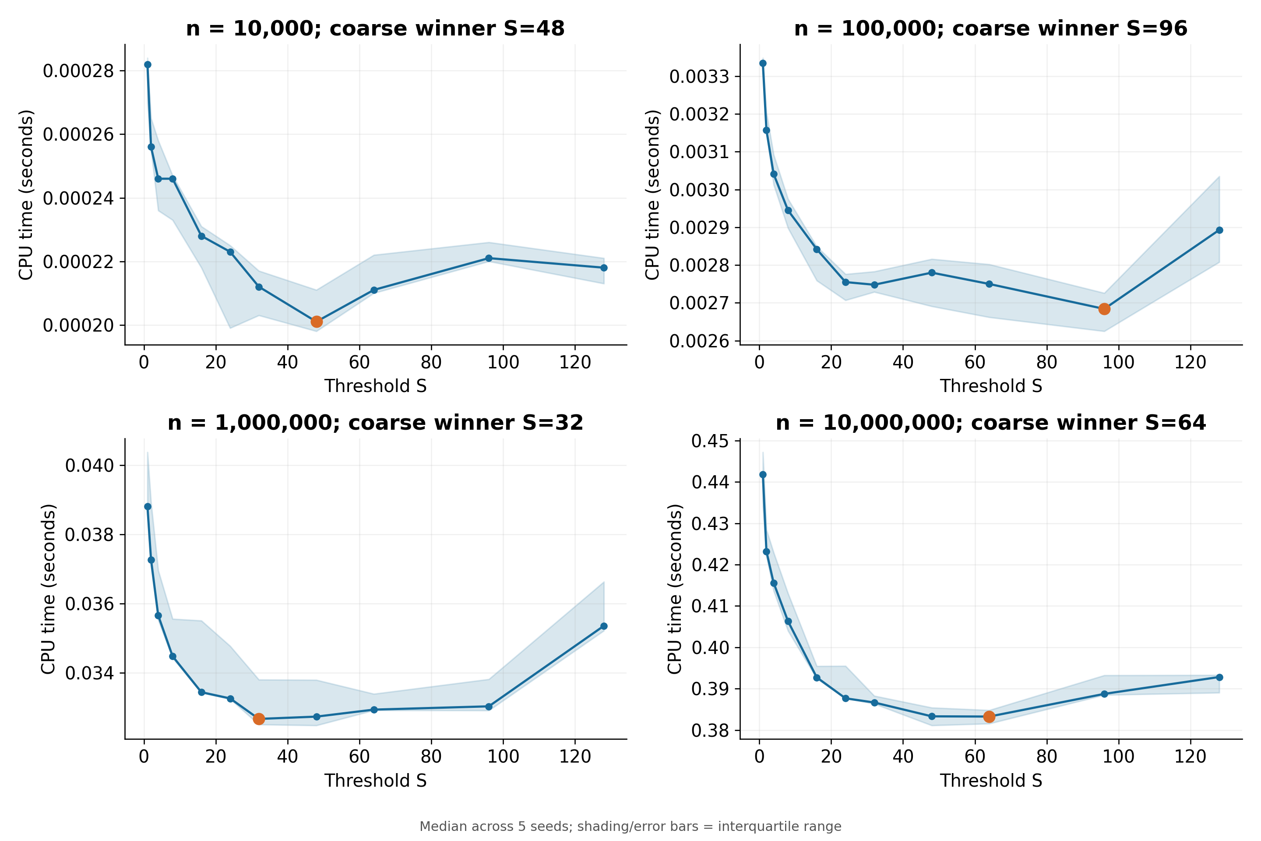
BACKUP A / THRESHOLD SENSITIVITY
CPU time across four input sizes
MERGE SORT + INSERTION SORT
09
Notes:
Coarse runtime winners differ across sizes. IQRs overlap for several candidates. Threshold selection is empirical and environment-specific.

Slide 10
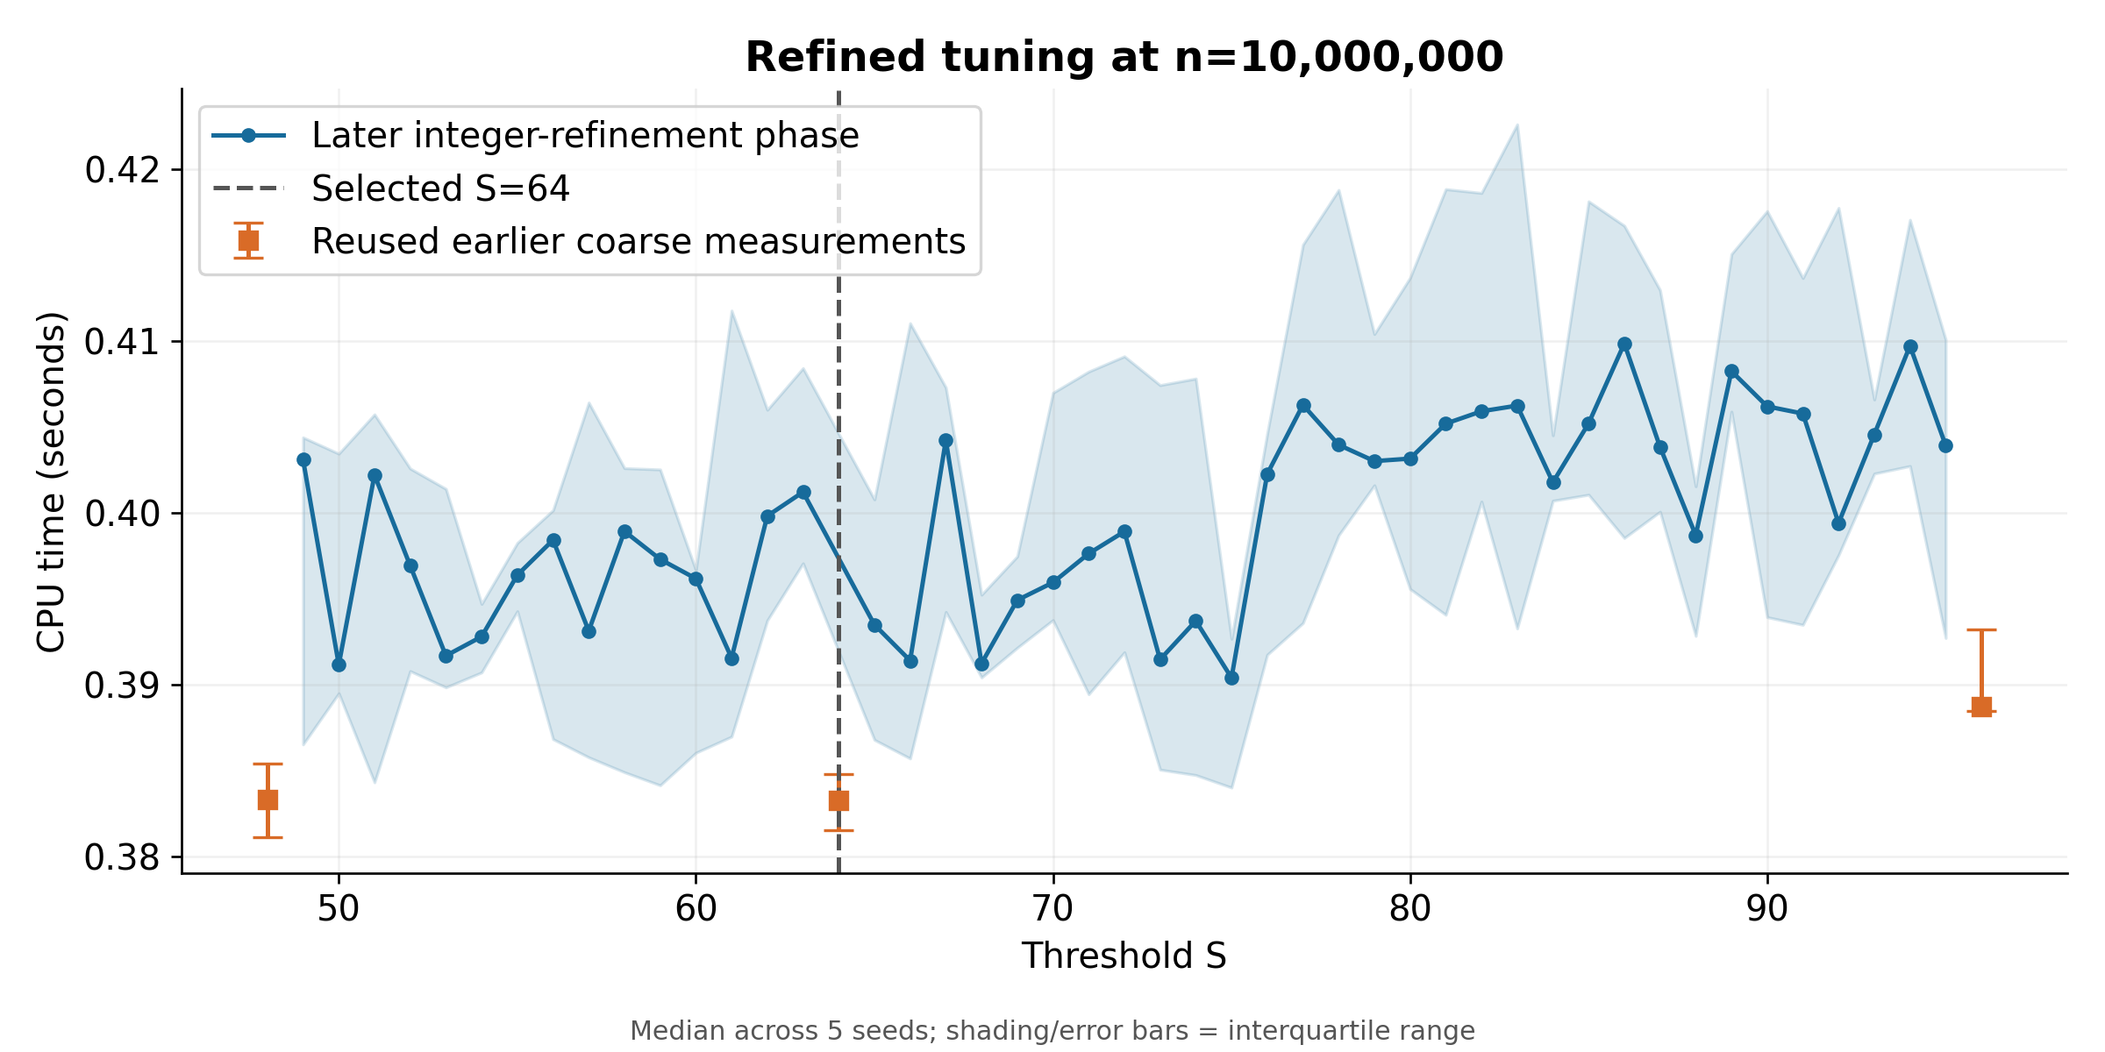
BACKUP B / WHY THE EXACT OPTIMUM IS UNCERTAIN
Refinement reveals run-phase variation
At n=10m, S=39–75 gives identical leaves (38 or 39 elements). Tiny ranks are not robust.
MERGE SORT + INSERTION SORT
10
Notes:
Orange markers reuse earlier coarse observations; blue points were measured in the later fine sweep. Their systematic timing difference within the same recursion partition is evidence of a measurement-phase limitation, not threshold-induced algorithmic work. The held-out S=64 vs original result is the basis for the runtime claim.

Slide 11
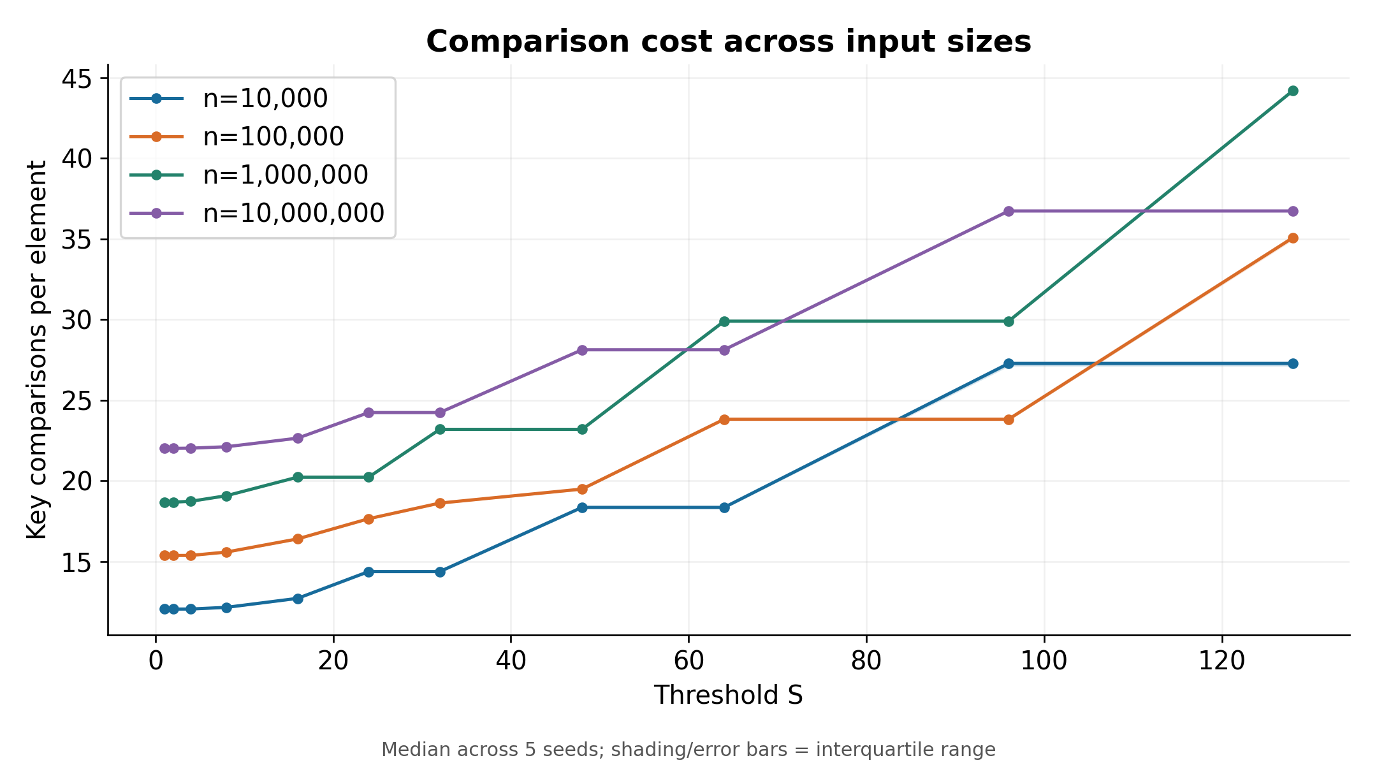
BACKUP C / COMPARISON COST
Key comparisons per element across input sizes
MERGE SORT + INSERTION SORT
11
Notes:
The curves cross because per-element insertion work depends on actual recursive leaf lengths, not just S. Counts are normalized by n here, not by n log n. Same-partition thresholds have identical comparisons on each seed.

Slide 12
BACKUP D / COUNTING DEFINITIONS
Count data comparisons, including the final false one
Insertion example: [2, 1, 3]
Merge example: [1, 3] + [2, 4]
2 > 1 → true; shift 2
2 > 3 → false; stop
Total: 2 key comparisons
1 ≤ 2; 3 ≤ 2; 3 ≤ 4
Copy remaining 4 without comparing
Total: 3 key comparisons
Excluded: index checks, loop bounds, copying, and exhaustion checks.
Count=true records uint64 comparisons.
Count=false removes counter increments at compile time.
MERGE SORT + INSERTION SORT
12
Notes:
Insertion uses j>left && previous>key. Short circuit at the left boundary does not evaluate another key comparison. Sorted or all-equal length four: 3 comparisons; reverse length four: 6.

Slide 13
BACKUP E / VERIFICATION
Correctness and complete experiment coverage
2,020 recorded passes
505 configuration/seed groups; all required sizes and repeats
Algorithm checks
Independent checks
Empty, singleton, odd lengths
Sorted, reversed, equal, duplicate keys
Random arrays and signed extremes
S=1 exactly matches original counts
Exact std::sort reference equality
Address + undefined-behavior sanitizers
CSV coverage audit
Threshold recomputed from saved data
MERGE SORT + INSERTION SORT
13
Notes:
Tests cover lengths 0–260 over random trials and multiple thresholds. Stable behavior follows from strict-greater insertion and left-first merge ties; integer reference checks alone do not test identity ordering among equal keys. Source: results/full/verification.md and audit.txt.

Slide 14
BACKUP F / METHOD DETAILS
Reproducible measurements; explicit limitations
Data & timing
Interpretation limits
mt19937 + unbiased rejection sampling
Tuning: 101, 202, 303, 404, 505
Validation: 1101, 1202, 1303, 1404, 1505
Three timed repetitions per seed
CPU: std::clock; elapsed: steady_clock
Five seeds; IQR is not a confidence interval
Coarse and fine phases occur at different times
Small inputs are timer-resolution sensitive
One machine and uniform input distribution
No alternative-distribution benchmarks claimed
Regenerate: make test → scripts/run_experiments.py → scripts/plot_results.py
MERGE SORT + INSERTION SORT
14
Notes:
Do not mix smoke-test outputs with full experiment evidence. The sorting auxiliary array is O(n); the benchmark keeps four integer arrays, about 160 MB at n=10m. Fresh seeds prevent retuning to held-out results.

Slide 15
BACKUP G / Q&A
Questions we should all be able to answer
Why can insertion sort help?
Quadratic work stays in small leaves; recursion and copying costs fall.
Why do thresholds form plateaus?
Several S values stop at the same recursive subarray sizes.
Why not minimize comparisons?
CPU time also includes movement and control overhead.
Is S=64 universally optimal?
No. It is the best observed candidate under this implementation and run.
Does the graph prove the complexity?
No. The derivation establishes the bound; measurements test consistency.
MERGE SORT + INSERTION SORT
15
Notes:
All team members should rehearse answering these questions. Sources: supplied Project 1.pdf and info.pdf; implementation src/sorting.hpp; experimental evidence results/full/measurements.csv. Eight main slides total eight minutes; seven backup slides are for Q&A only.

